Slide 1
Airbnb New User Bookings
Predicting User Destinations from the Airbnb Dataset

Slide 2
Project Proposal
Overview
Here in this capstone project, the objective is to build an ML model that can predict where a new Airbnb user is likely to book his/her stay.
Client & Data
In this scenario, the client would be Airbnb which is an online marketplace for arranging or offering lodging, primarily homestays, or tourism experiences. The company does not own any of the real estate listings, nor does it host events; it acts as a broker, receiving commissions from each booking.
The desired data is provided by the client while hosting a Data Science competition on Kaggle.com in 2015.
Company

Slide 3
Approach
Data Wrangling:
The very first step will be to import the data into a jupyter notebook and explore it so that the anomalies can be identified and dealt with. Further analysis and model building will be done on the cleaned datasets.
EDA using visualization & statistical methods:
Once the data has been cleaned, it will be explored to understand relationships between the variables using inferential statistics. Multiple hypotheses will be drawn and validated in this step which will shape the procedure for initial predictive model building.
Model building:
Multiple ML methods will be used to build a predictive model and will be improved by testing against the test dataset provided by Airbnb.
Data story and results:
This step will involve creating a story around the initial problem, the problem it aims at solving and the insights gained from the data. Along with that, it will explain the challenges faced during model building as well as the results with accuracy.
Company

Slide 4
Data Wrangling
• First, both the train & test data was imported and merged, so that all the operations can be performed on the entire dataset. In total it had 275547 users’ activity data.
• Once the structure of the dataset was clear all the missing values were checked. 46% users did not disclose their gender.
• Similarly, there were 42% of users without any age information. In addition to that, I came across a few outliers in the age column. 830 of the users had mentioned their age of more than 115 years. Which I excluded and kept the data with the age range of 13 to 95 years.
• I checked the ‘country_destination’ column against the gender column. But could not find any noticeable difference between both the genders.
• The first thing I could see that if there was a reservation, it was likely to be inside the US. But there were around 45% of people that never did any reservation.
• After that, I compared it against age and came to know that the common age to travel was between 25 and 45.
Company

Slide 5
Exploratory Data Analysis
Company

Slide 6
Country Statistics
The countries that are represented in this dataset largely consist of an aging population. The largest groups are people with mean ages 47 years and 52 years.
One very interesting thing to note is that the sex ratio is skewed towards men for younger age groups but as the mean age increases, the ratio skews more towards women. Women indeed live longer than men.
There is a negative correlation between country preference and country distance.
The correlation is more complicated for language levenshtein distance (Negative including US but positive excluding it).

Slide 7
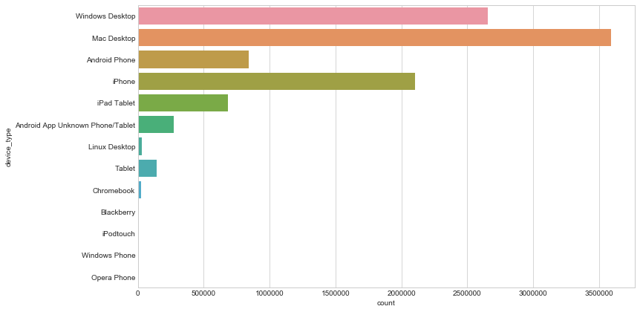
Device Usage during Sessions

Slide 8
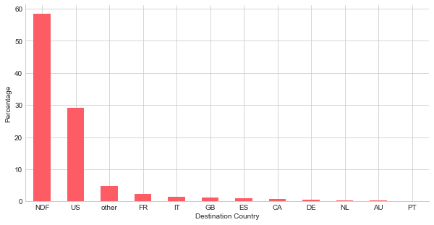
Destination Popularities

Slide 9
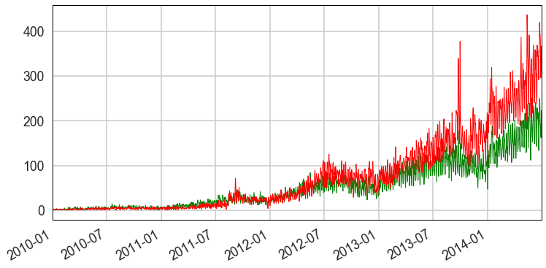
Trends of users booking Airbnbs

Slide 10
Feature Engineering and Model building

Slide 11
Session Data
The following features were constructed from the session data:
Number of Sessions: The total number of sessions registered by the user.
Number of types of Sessions: The distinct types of activities logged by a particular user.
Total Seconds: The total amount of time spent by the user on Airbnb
Average Seconds: The average amount of time spent in each session by the user.
Short Sessions: The number of sessions which were less than 5 minutes long.
Long Sessions: The number of sessions which were more than 2000 seconds (or 33 minutes and 20 seconds) long.
Number of Devices: The number of devices used by the user to use the website.

Slide 12
Training Data
The Training dataset contained the bulk of the feature engineering performed to come up with the final training dataset.
All the date features were removed as they were not of too much use to us considering that the test dataset begins somewhere during mid 2014. So all our analysis regarding users dating back to 2010 is moot.
From the insights gained in the exploratory data analysis section, the number of categories were reduced for each variable in such a way so as to increase disparity.
One hot encoding was performed on these categorical variables to arrive at the final training dataset.

Slide 13
Model Choice
Two models were tested for their accuracy: Logistic Regression and Random Forest Classifier.
The Random Forest Classifier had the highest accuracy of close to 60% whereas Logistic Regression performed with an accuracy of 58%.
In future we can use some other algorithms to refine the results further.

Slide 14
Testing and Final Score
The tuned classifier was used to predict outcomes on the test dataset.
The submission dataframe was constructed with the top 3 destinations for each users based on the value of their prediction probabilities.
This dataset was uploaded to Kaggle and the score achieved was 0.84062

